Slide 1
CIS8695 Managing Big Data Analytics
Nasim Mousavi
Assistant Professor
J. Mack Robinson College of Business
Georgia State University
nmousavi@gsu.edu

Slide 2
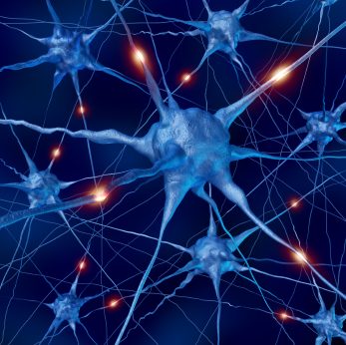
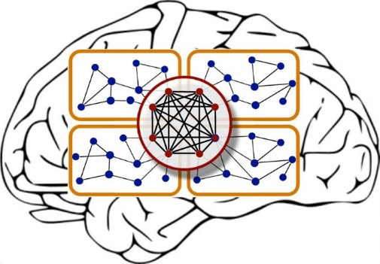
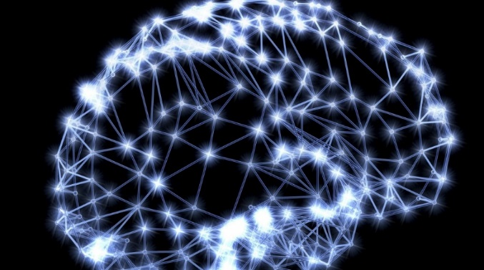
Neural Networks
Also called artificial neural networks (ANN)
Used for classification and prediction
Mimics human neurons and the way that human experts learn
Neurons are interconnected and learn from experience

Slide 3
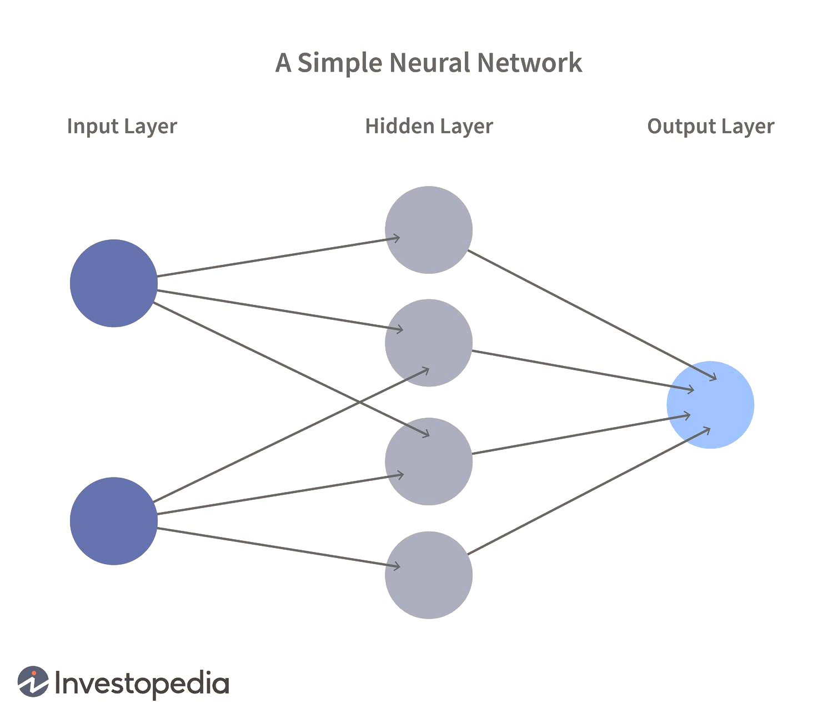
Schematic Diagram
Notes:
Nodes and layers

Slide 4
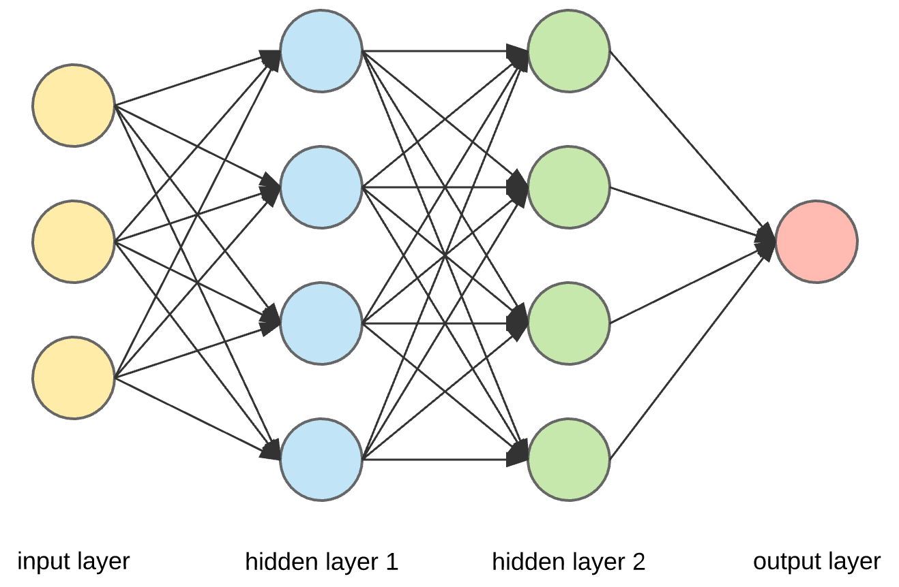
Schematic Diagram
Notes:
Nodes and layers

Slide 5
Neural Network: Activation Function
How to transform input to output:
Using a function called Activation Function or Transfer Function
We have two general types of activation function:
Linear functions
Non-linear functions
Notes:
Nodes and layers

Slide 6
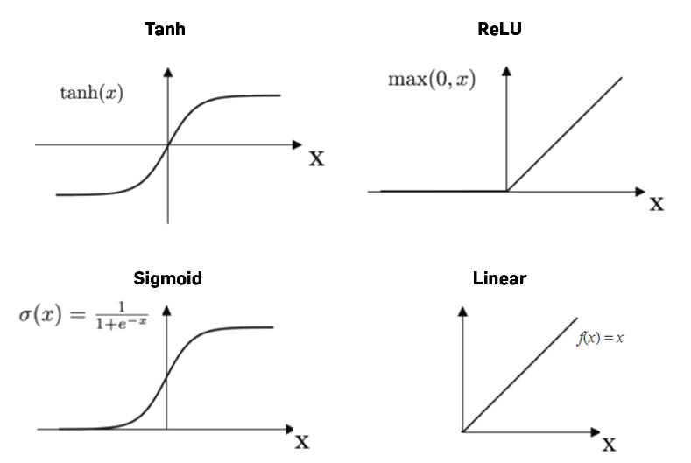
Neural Network: Activation Function
Notes:
Nodes and layers

Slide 7
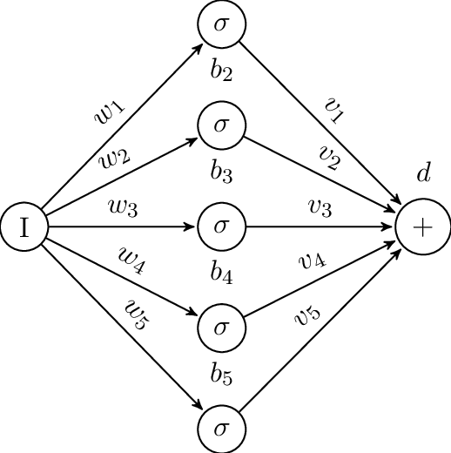
Network Structure
Multiple layers
Input layer (observations)
Hidden layers
Output layer
Weights (like coefficients, subject to iterative adjustment)
Bias values (like intercepts)
A constant that helps the activation function to shift in the positive or negative side

Slide 8
Neural Network
Notes:
Nodes and layers

Slide 9
General Structure of NN
Training NN means learning the weights of the neurons
Notes:
Nodes and layers

Slide 10
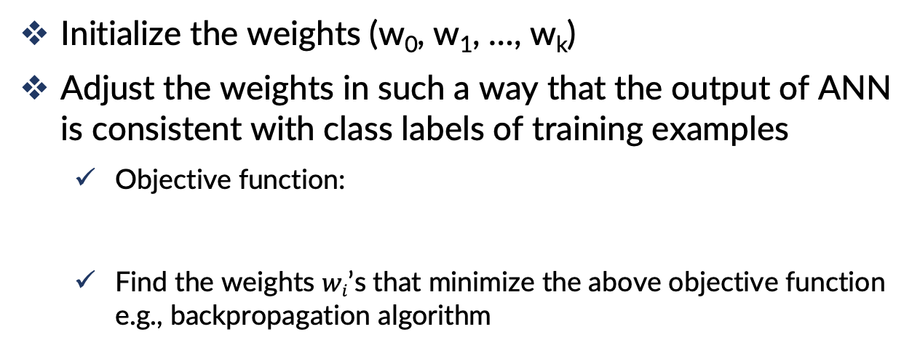
General Structure of NN
Initialize the weights (w₀, w₁, …, w_{k})
Adjust the weights in such a way that the output of ANN is consistent with class labels of training examples
Objective function:
Find the weights $wi$’s that minimize the above objective function e.g., backpropagation algorithm
Notes:
Nodes and layers

Slide 11
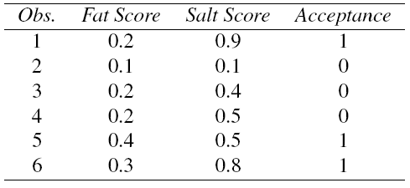
Example
Using fat & salt content to predict consumer acceptance of cheese

Slide 12
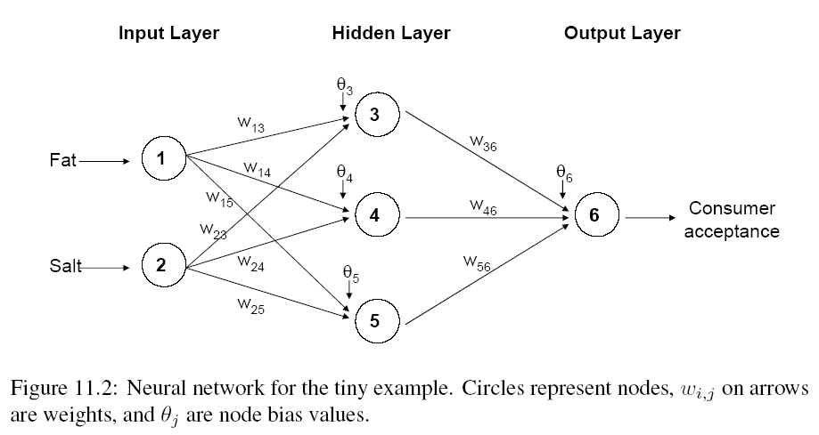
Example

Slide 13
Moving Through the Network

Slide 14
The Input Layer
For input layer, input = output
E.g., for record #1:
Fat input = output = 0.2
Salt input = output = 0.9
Output of input layer = input into hidden layer
0.2
0.2
0.9
0.9

Slide 15
The Hidden Layer
In this example, hidden layer has 3 nodes
Each node receives as input the output of all input nodes
Output of each hidden node is a function of the weighted sum of inputs
0.2
0.2
0.9
0.9

Slide 16
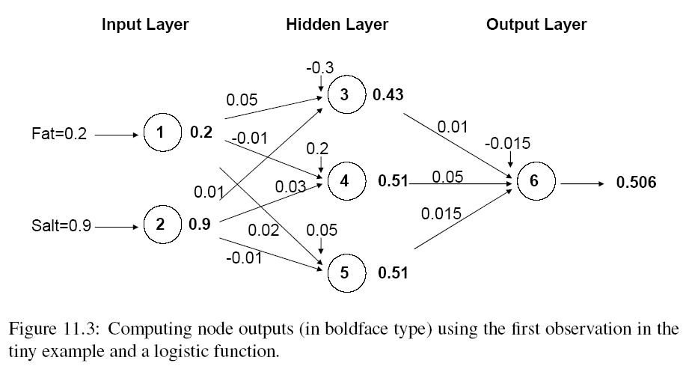
Output of Node 3, if g is a Logistic Function
θ₃
w₁₃
w₂₃

Slide 17
The Output Node

Slide 18
Mapping Output to Classification
Output = 0.506
If cutoff for class “1” is 0.5, then we classify as class “1”

Slide 19
Training the Model

Slide 20
Preprocessing Steps
Scale variables to 0-1
Transform (e.g., log) skewed variables

Slide 21
Weights
The weights w are typically initialized to random values in the range -0.05 to +0.05
These initial weights are used in the first round of training

Slide 22
Initial Pass Through Network
Goal: Find weights that yield best predictions
The process we described in the simple example is repeated for all records
At each record, compare prediction to actual target value
Difference is the error for the output node
Error is propagated back and distributed to all the hidden nodes and used to update their weights

Slide 23
Initial Pass Through Network

Slide 24
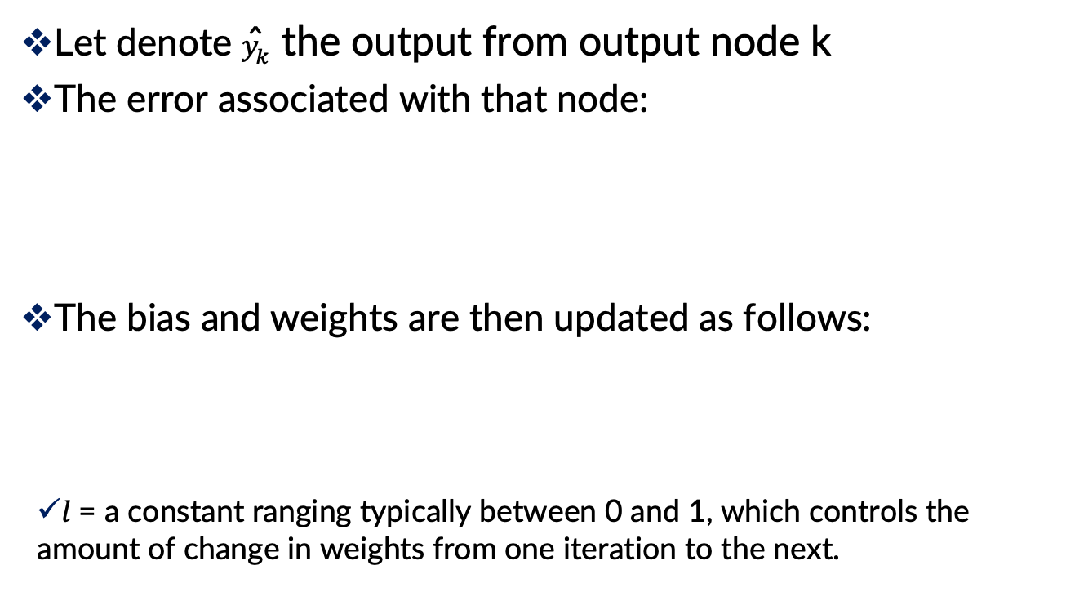
Back Propagation (“back-prop”)
Let denote ${\hat{y}}_{k}$ the output from output node k
The error associated with that node:
The bias and weights are then updated as follows:
$l$ = a constant ranging typically between 0 and 1, which controls the amount of change in weights from one iteration to the next.

Slide 25
Updating Methods
Two updating methods:
Case updating
The parameter values are updated after each record is run through the network
Batch updating
the entire training set is run through the network before each updating of the bias and weights takes place
In practice, case updating tends to yield more accurate results than batch updating, but requires a longer run time.

Slide 26
When Does the Updating Stop?
1. When the new values of the bias and weights are only incrementally different from those of the preceding iteration
2. When the misclassification rate reaches a required threshold
3. When the limit on the number of runs is reached

Slide 27
Avoiding Overfitting
With sufficient iterations, neural net can easily overfit the data
To avoid overfitting:
Track error in validation data
Limit iterations
Limit complexity of network

Slide 28
Advantages
Good predictive ability
Can capture complex relationships
No need to specify a model

Slide 29
Disadvantages
Considered a “black box” prediction machine, with no insight into relationships between predictors and outcome
No variable-selection mechanism, so you have to exercise care in selecting variables
Heavy computational requirements if there are many variables (additional variables dramatically increase the number of weights to calculate)

Slide 30
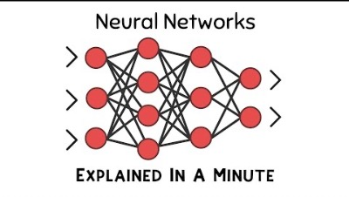
Conclusion

Slide 31
Deep Learning

Slide 32
Deep Learning
The statistical and machine learning models work where you have informative predictors (purchase information, bank account information, # of rooms in a house, etc.)
In rapidly-growing applications of voice and image recognition, you have high numbers of “low-level” granular predictors - pixel values, wave amplitudes, uninformative at this low level

Slide 33
Deep Learning
Deep neural nets with many layers have facilitated in image/voice recognition
Key is the ability to self-learn features (“unsupervised”)
Starts with learning local, simple features and then move to more global & complex features

Slide 34
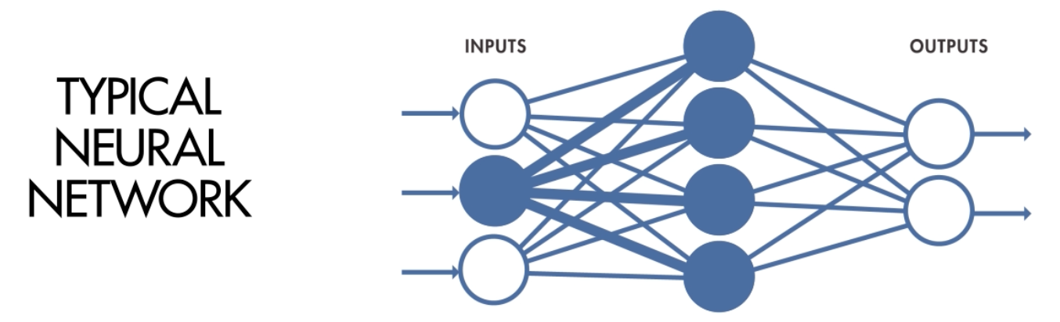
Deep Learning
In a standard neural network, each predictor gets its own weight at each layer of the network

Slide 35
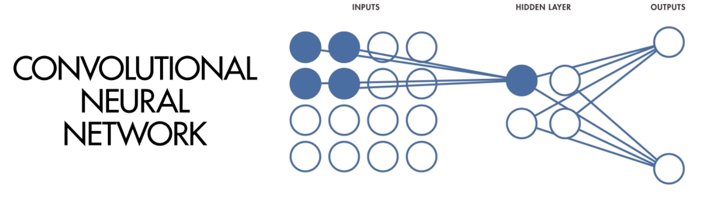
Deep Learning
A convolution, by contrast, selects a subset of predictors (pixels), and applies the same operation to the entire subset
It is this grouping that fosters the automated discovery of features

Slide 36
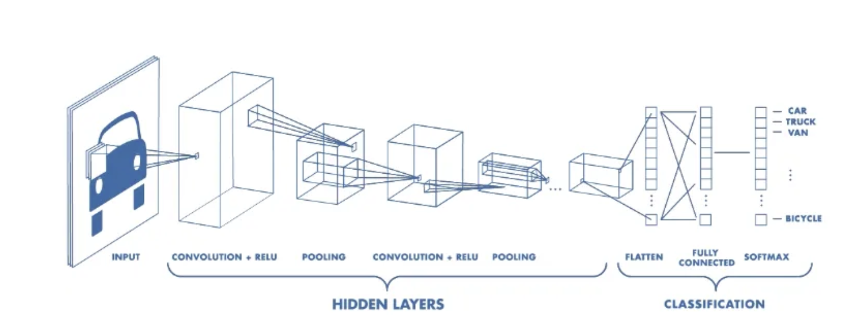
Deep Learning: CNN
A CNN typically has three layers: a convolutional layer, a pooling layer, and a fully connected layer.

Slide 37
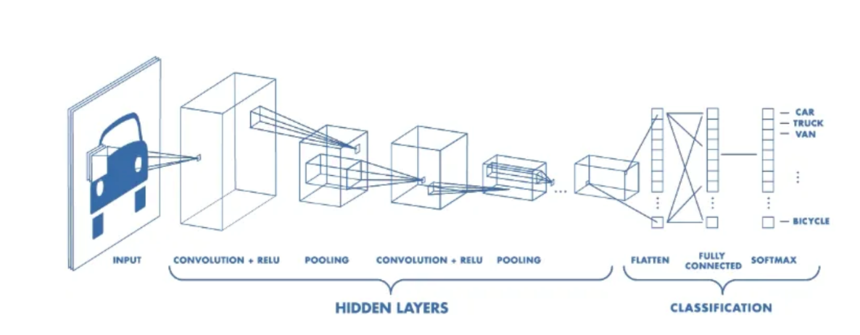
Deep Learning: CNN
The convolutional layer applies filters to the input image to extract features
The pooling layer down samples the image to reduce computation
The fully connected layer makes the final prediction
The network learns the optimal filters through backpropagation

Slide 38
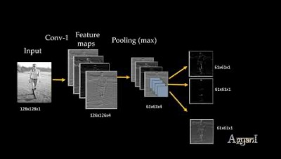
Deep Learning: CNN

Slide 39
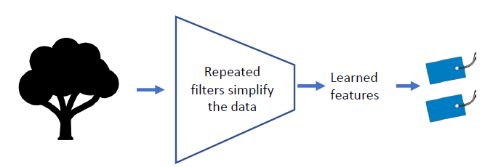
The Learning Process
In supervised learning, the net retains those convolutions and features which are successful in labeling (tagging) images
Note that the feature-learning process yields a reduced (simpler) set of features than the original set of pixel values
training data has known labels

Slide 40
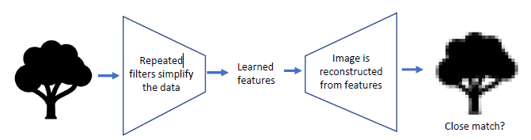
The Learning Process: Auto-Encoder
Deep learning nets can learn higher level features even when there are no labels to guide the process
The net adds a process to take the high level features and generate an image
The generated image is compared to the original image and the net retains the architecture that produces the best matches

Slide 41
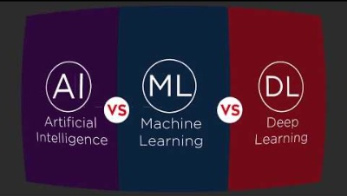
AI vs. ML vs. DL

